Slide 1

JavaScript Programming
Information Technology
document Object

Slide 2


Slide 3
The Document Object
The document object is the highest object within the HTML DOM (Document Object Model) Structure
The document object is a property of the global window object
We can use the document object to manipulate the HTML within a page DOM

Slide 4
Writing to an HTML page using document
<!DOCTYPE html> <html>
<head> <script>
let firstName = prompt(“What is your first name?”);
let lastName = prompt(“What is your last name?”); </script> </head> <body>
<h1>My Page writing to the DOM using the document object</h1>
<script>
document.write(`<p>My name is <b>${firstName} ${lastName}</b> and I am a life long student of Computer Science.</p>`);
</script>
<p>My name should be displayed above this paragraph.</p>
</body> </html>

Slide 5
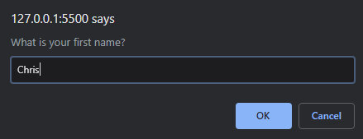
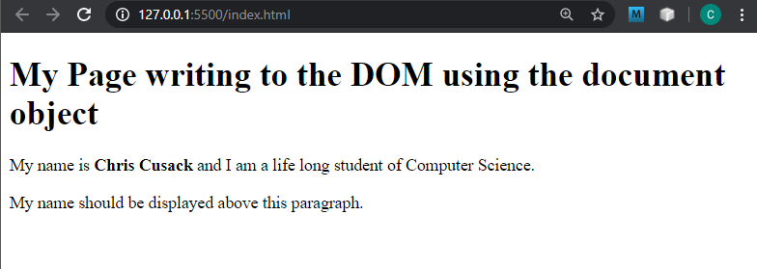
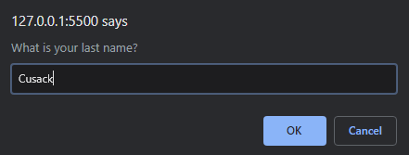

Slide 6
Exercise
Create Repo JavaScriptProgrammingEx4
Add instructor as collaborator
Clone to you computer
Open the cloned directory in VS Code
Code along

